Slide 1


Final Year Project Proposal
Sentinel-X: Secure AI-Powered Wi-Fi Indoor Positioning and Intelligent Asset Tracking System
Supervised By: Syed Yawar Abbass Zaidi

Slide 2
Project Team
Muhammad Awais Ali (53015)
Abdul Ahad (47374)

Slide 3
Table of Content
Opportunity & Stakeholders
Existing Systems
Problem Statement
Proposed Solution
Project Scope
Timeline

Slide 4
Opportunity & Stakeholders
Why a secure, AI-powered indoor positioning system is needed, and who benefits

Slide 5
Opportunity & Stakeholders
Opportunity | Stakeholders
GPS is unreliable indoors, leaving universities, labs, hospitals, and offices without accurate real-time asset or personnel location. | Faculty of Computing, Riphah International University
Existing options (RFID, BLE, UWB) are costly or difficult to scale; Wi-Fi reuses existing infrastructure, making it a more affordable option. | Campus administrators and IT/security staff who would monitor assets through the dashboard
Most Wi-Fi positioning research overlooks cybersecurity, creating an opportunity for a secure, AI-enhanced alternative. | Future adopters in hospitals, laboratories, and offices with similar indoor tracking needs

Slide 6
Existing Systems
Reviewing Wi-Fi, BLE, RFID and UWB indoor positioning research

Slide 7
Existing Systems
Technologies: RFID, BLE, UWB and Wi-Fi have all been used for indoor positioning; Wi-Fi is favored for reusing existing network infrastructure and lower cost
Beigi & Shah-Mansouri (2024): Hybrid Wi-Fi + BLE localization with ESP32, Kalman Filter and RNN; good accuracy but no dedicated security
Long et al. – EP-3DLoc: RSSI-based localization across multi-building, multi-floor environments using data completion and position-related features
Hussein et al.: MCA-based noise reduction with LSTM classification reported 97.5% accuracy, but did not address security
Common gap: Existing systems emphasize localization accuracy while giving limited attention to authentication, encryption and anomaly detection

Slide 8
Comparison Chart of Existing Systems
System / Study | Technology | AI / ML | Security | Main Limitation | Sentinel-X Improvement
Beigi & Shah-Mansouri (2024) | Wi-Fi + BLE / ESP32 | Kalman Filter, KNN, RNN | No dedicated security | Mainly focuses on localization | Adds security, anomaly detection, dashboard & asset monitoring
Adaptive Wi-Fi Fingerprinting (2024) | Wi-Fi RSSI | DNN | Not addressed | Needs complex data and high computing resources | Uses simpler, low-cost AI techniques
Wi-Fi Fingerprinting Datasets Review (2024) | Wi-Fi RSSI | Fingerprinting | Not addressed | Sensitive to environmental changes | Uses RSSI calibration and AI-assisted localization

Slide 9
Cont..
System / Study | Technology | AI / ML | Security | Main Limitation | Sentinel-X Improvement
Comparative Analysis on Wi-Fi Indoor Positioning (2024) | Wi-Fi RSSI | AI Fingerprinting | Limited | Focuses mainly on positioning | Combines positioning, security and asset tracking
ML-Based Wi-Fi/BLE Survey (2024) | Wi-Fi + BLE | KNN, CNN, DNN, SVM, RF | Generally, not considered | Focuses on accuracy and overlooks security/cost | Focuses on affordability, security and practical deployment
Sentinel-X | Wi-Fi / ESP32 | Kalman Filter, KNN, Isolation Forest | AES-256, TLS, JWT, RBAC, Replay Protection | Prototype for controlled indoor environment | Integrated secure AI-based indoor asset tracking

Slide 10
Problem Statement
Accurate, secure, low-cost indoor asset tracking is still unsolved

Slide 11
Problem Statement
Universities and labs hold valuable equipment that needs continuous, secure, real-time monitoring
Existing tracking methods are manual, expensive, or offer limited real-time visibility
Available indoor positioning technologies often need costly hardware or lack adequate cybersecurity protection
Wi-Fi-based systems suffer from inaccurate position estimates due to RSSI fluctuations from environmental interference
Absence of intelligent anomaly detection limits the ability to catch unauthorized asset movement or suspicious activity
Need: A secure, intelligent, cost-effective indoor positioning system that improves accuracy while protecting communication and location data

Slide 12
Proposed Solution
Sentinel-X: AI-powered, security-first Wi-Fi indoor positioning

Slide 13
Proposed Solution
Hardware: ESP32-based tracking tags and anchor nodes collect Wi-Fi RSSI data from indoor assets and users
Localization: RSSI calibration and Kalman Filtering reduce noise, followed by KNN fingerprinting
AI security layer: Isolation Forest detects abnormal movement patterns and unauthorized asset relocation
Secure communication: AES-256 encryption, TLS, JWT authentication, and role-based access control
Messaging: MQTT provides lightweight communication between ESP32 devices and the backend
Dashboard: Web app for real-time location, movement history and security alerts

Slide 14
Tools and Technologies
Category | Technologies
Hardware | ESP32, Wi-Fi Router, Computer/Laptop
Programming | Python, Arduino IDE
Backend | Flask / Fast API
Frontend | React.js
Database | PostgreSQL
Communication | Wi-Fi, MQTT / Mosquitto
AI / ML | KNN, Isolation Forest, Kalman Filter
Security | AES-256, TLS, JWT, RBAC
Development | VS Code, Git & GitHub, Postman

Slide 15
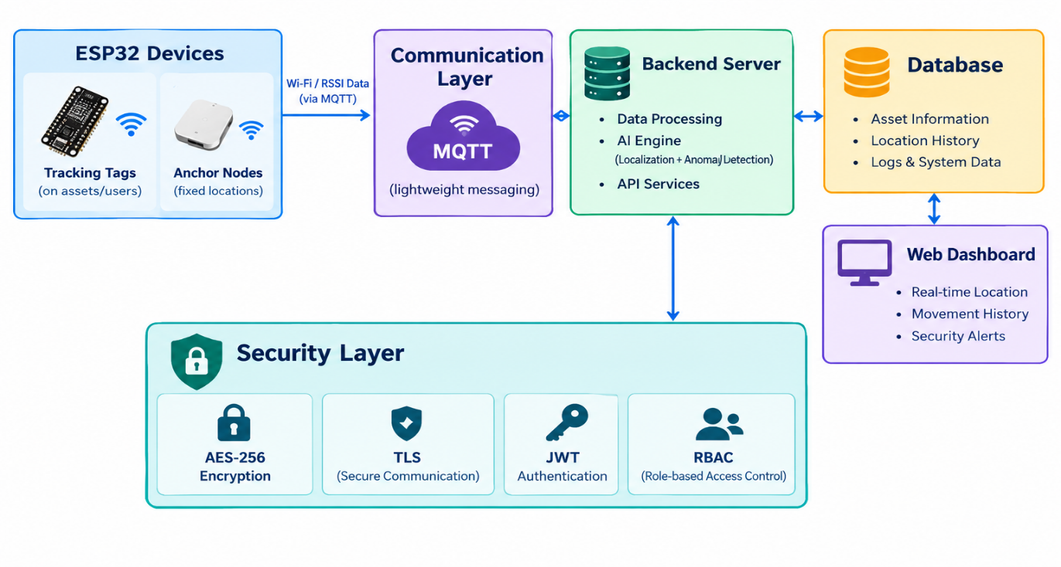
System Architecture

Slide 16
Proposed Methodology
Literature Review
Requirements
System Design
Hardware Setup
RSSI Data Collection
Signal Processing
KNN Localization
Isolation Forest
Security
Dashboard
Testing

Slide 17
Project Scope
A secure indoor positioning prototype for a university lab environment

Slide 18
Project Scope
Hardware: ESP32 tracking tags and anchor nodes for Wi-Fi/RSSI data collection
Indoor Positioning: Collect RSSI from multiple anchors, process it, and estimate real-time asset position
AI/Processing: Kalman Filter for RSSI smoothing, KNN/fingerprinting for location estimation, Isolation Forest for abnormal movement
Communication: MQTT for transferring data from ESP32/anchors to the backend
Web Dashboard: Real-time asset location, status, movement history and alerts
Security: Authentication, secure MQTT, encryption/TLS, anomaly detection
Database: Stores asset information, location history, logs and system data
Scope boundary: Prototype developed and evaluated within a university laboratory or similar indoor environment

Slide 19
Project Scope
Main Scope:
Development of a secure indoor positioning prototype for a university laboratory or similar indoor environment.
Key Areas
Hardware
  ESP32 tracking tags
  ESP32 anchor nodes
  Wi-Fi/RSSI data collection
Indoor Positioning
  Collect RSSI from multiple anchors
  Process RSSI data
  Estimate real-time asset location

Slide 20
Cont...
AI Processing
  Kalman Filter for RSSI smoothing
  KNN/Fingerprinting for location estimation
  Isolation Forest for abnormal movement
Communication
  MQTT for device-to-backend communication
Security
  Authentication
  Secure MQTT communication
  Encryption/TLS
  Anomaly detection

Slide 21
Cont..
Web Dashboard
  Real-time asset location
  Asset status
  Movement history
  Alerts
Database
  Asset information
  Location history
  Logs and system data
Scope Boundary:
  The prototype will be developed and evaluated within a university laboratory or similar indoor environment

Slide 22
Timeline

Slide 23
Timeline
Weeks | Phase | Key Activities
1–3 | Research | Literature Review, AI & Cybersecurity Study
4–6 | Finalization | Feasibility Study, Proposal Refinement & Faculty Approval
7–9 | Setup & Data | System Design, ESP32 Setup, Wi-Fi & RSSI Data Collection
10–12 | AI & Security | Kalman Filter, KNN, Isolation Forest, AES-256, TLS, JWT & RBAC
13–14 | Integration & Testing | Dashboard, Integration, Testing, Evaluation & Final Report

Slide 24
Work Break Down Structure
Work Area | Muhammad Awais Ali | Abdul Ahad
1. Literature Review | Study existing Wi-Fi, BLE, RFID and UWB systems | Study AI/ML and cybersecurity techniques used in existing systems
2. Requirement Analysis | Define hardware and networking requirements | Define software, security and dashboard requirements
3. System Design | Design ESP32, Wi-Fi and MQTT communication flow | Design backend, database, AI and dashboard flow
4. Hardware Setup | Configure ESP32 tracking tags | Configure ESP32 anchor nodes and Wi-Fi network
5. RSSI Data Collection | Collect RSSI readings from tracking tags | Organize and prepare RSSI data for processing
6. RSSI Processing | RSSI calibration | Kalman Filtering and processed RSSI data
7. AI Localization | Prepare fingerprinting/location dataset | Implement KNN-based location estimation

Slide 25
Cont..
Work Area | Muhammad Awais Ali | Abdul Ahad
8. Anomaly Detection | Collect movement data and define normal movement patterns | Implement Isolation Forest for abnormal movement detection
9. Cybersecurity | Device/network security and secure MQTT | AES-256, TLS, JWT, RBAC and replay protection
10. Backend & Database | MQTT and device-to-backend communication | Flask/FastAPI backend and PostgreSQL database
11. Web Dashboard | Provide location/device data integration | Develop React.js monitoring dashboard
12. Testing | Test ESP32, Wi-Fi, RSSI and communication | Test AI, security, dashboard and database
13. Final Evaluation | Localization accuracy, communication latency and reliability | Anomaly detection, security and dashboard testing
14. Documentation | Hardware, networking and implementation documentation | AI, security, software and dashboard documentation
15. Final Presentation | Architecture, hardware and communication sections | AI, security, software and results sections

Slide 26


